Slide 1



Social Inequality Magnifies the Perception of Risk in a Pandemic
Nate Breznau Postdoc University of Bremen
✉ breznau.nate@gmail.com
Hung H.V. Nguyen Doctoral Researcher University of Bremen
Lisa Heukamp Doctoral Researcher University of Bremen
Aug. 18th, 2020

Slide 2

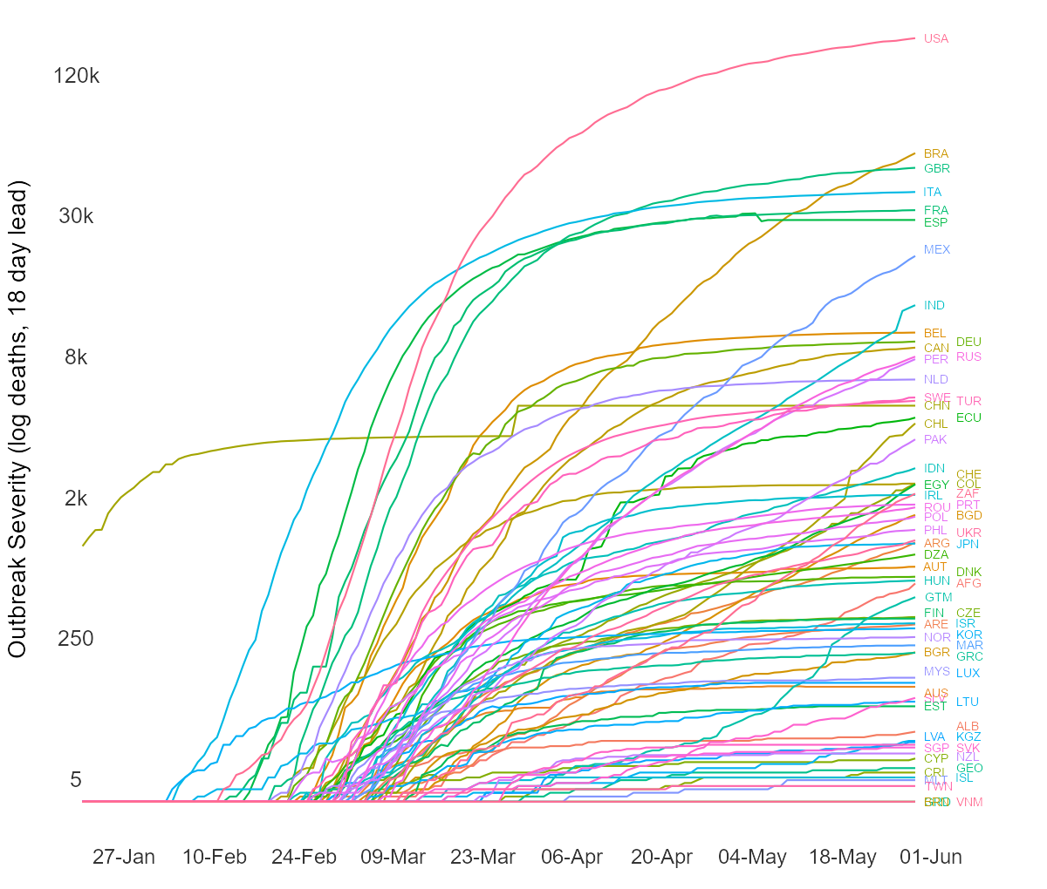
The Novel Coronavirus Pandemic
Fig 1. Outbreak Severity by Country
virus image source: https://www.scientificanimations.com

Slide 3

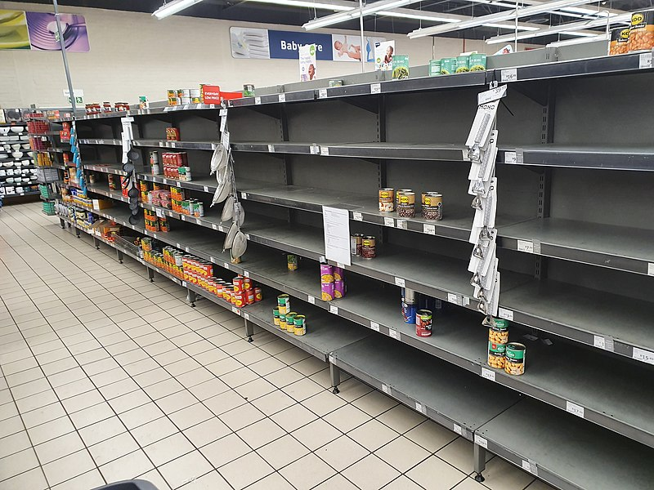
Risk Perceptions in the Pandemic
Image: https://www.theguardian.com/world/2020/may/15/coronavirus-death-toll-right-denies-figures
Image: https://commons.wikimedia.org/wiki/File:Paarl_RSA_COVID19_panic_shopping.jpg

Slide 4
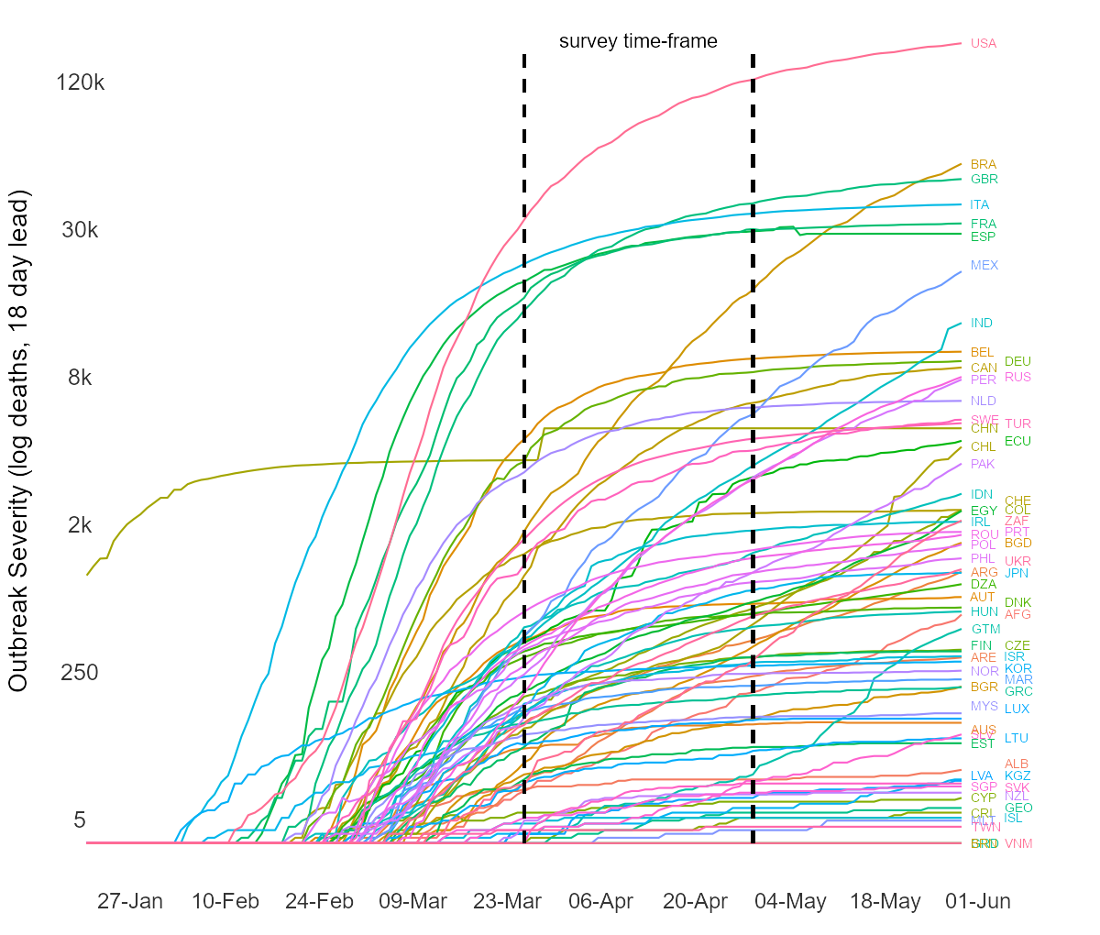
The COVIDiSTRESS Survey (Lieberoth et al, 2020)
Fig 1. Outbreak Severity by Country
Countries with no known deaths from COVID-19:
March 15th 174
April 15th 51
May 1st 37
virus image source: https://www.scientificanimations.com

Slide 5
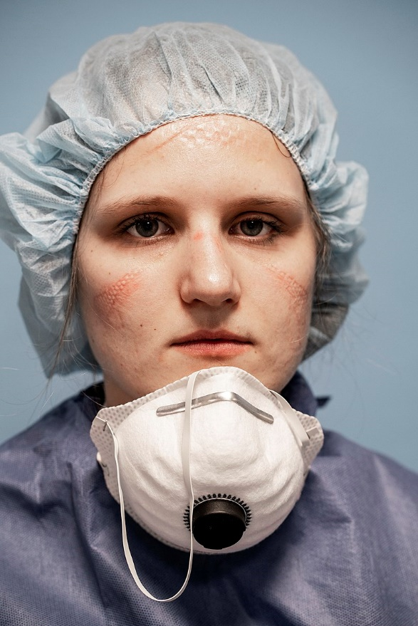
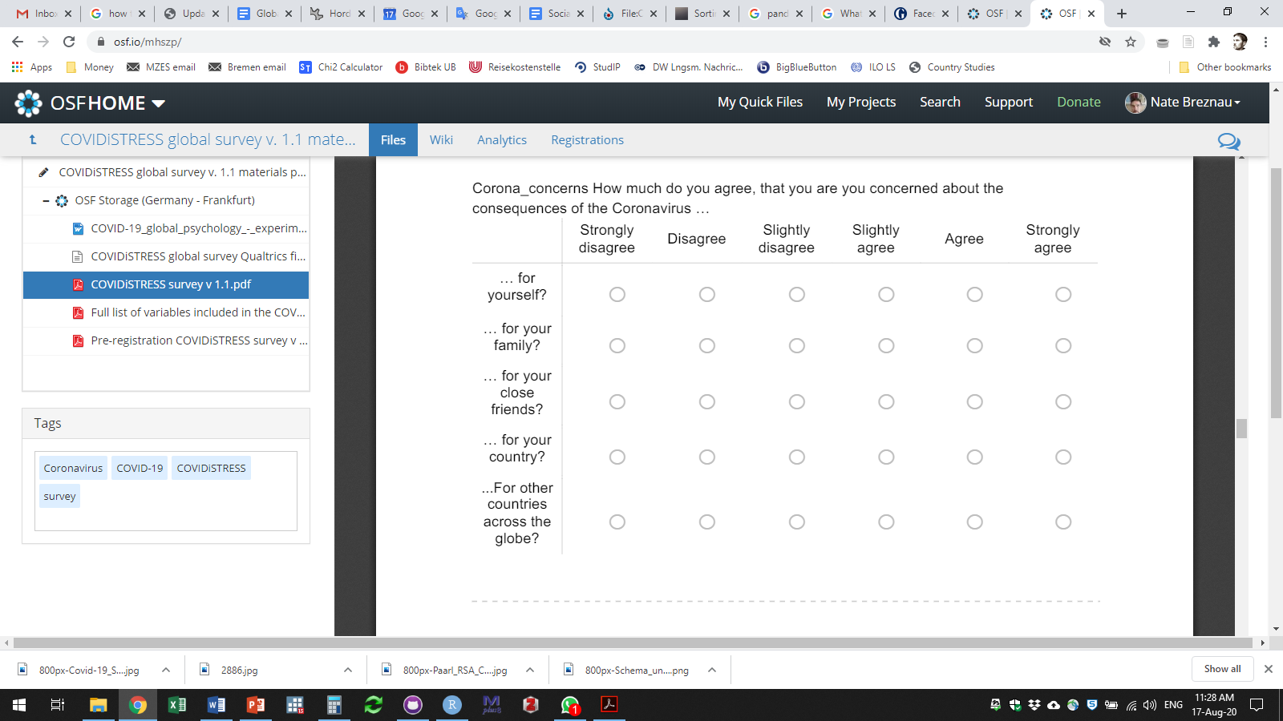
The COVIDiSTRESS Survey (Lieberoth et al, 2020)
How much do you agree, that you are you concerned about the consequences of the Coronavirus ...
https://commons.wikimedia.org/wiki/File:Covid-19_San_Salvatore_04.jpg

Slide 6
The COVIDiSTRESS Survey (Lieberoth et al, 2020)
How much do you agree, that you are you concerned about the consequences of the Coronavirus ...
Personal Risk Perceptions
https://commons.wikimedia.org/wiki/File:Covid-19_San_Salvatore_04.jpg
(Breznau 2020)

Slide 7
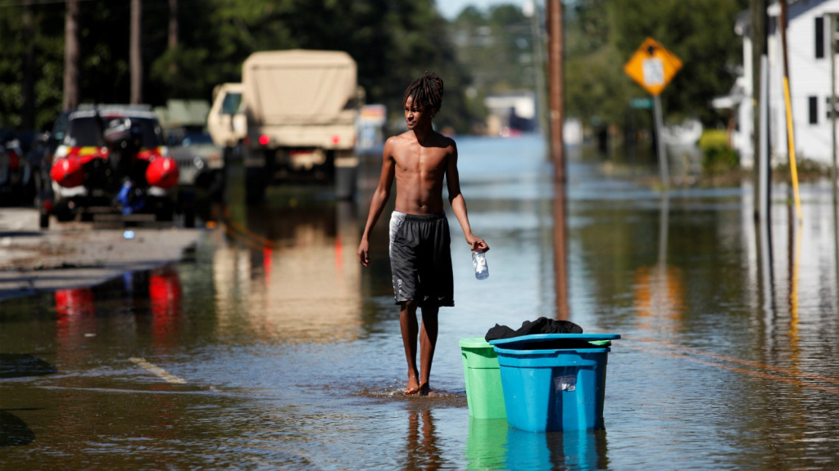
Risk Perceptions and Social Inequality
Social inequality increases personal & social risks
(Brady, Finnigan and Hübgen 2017; Van de Werfhorst, and Salverda 2012)
Poverty
Public health
Crime
Trust
Social mobility*
https://climatechange-theneweconomy.com/combination-climate-change-inequality-increasingly-drives-risk-2/

Slide 8
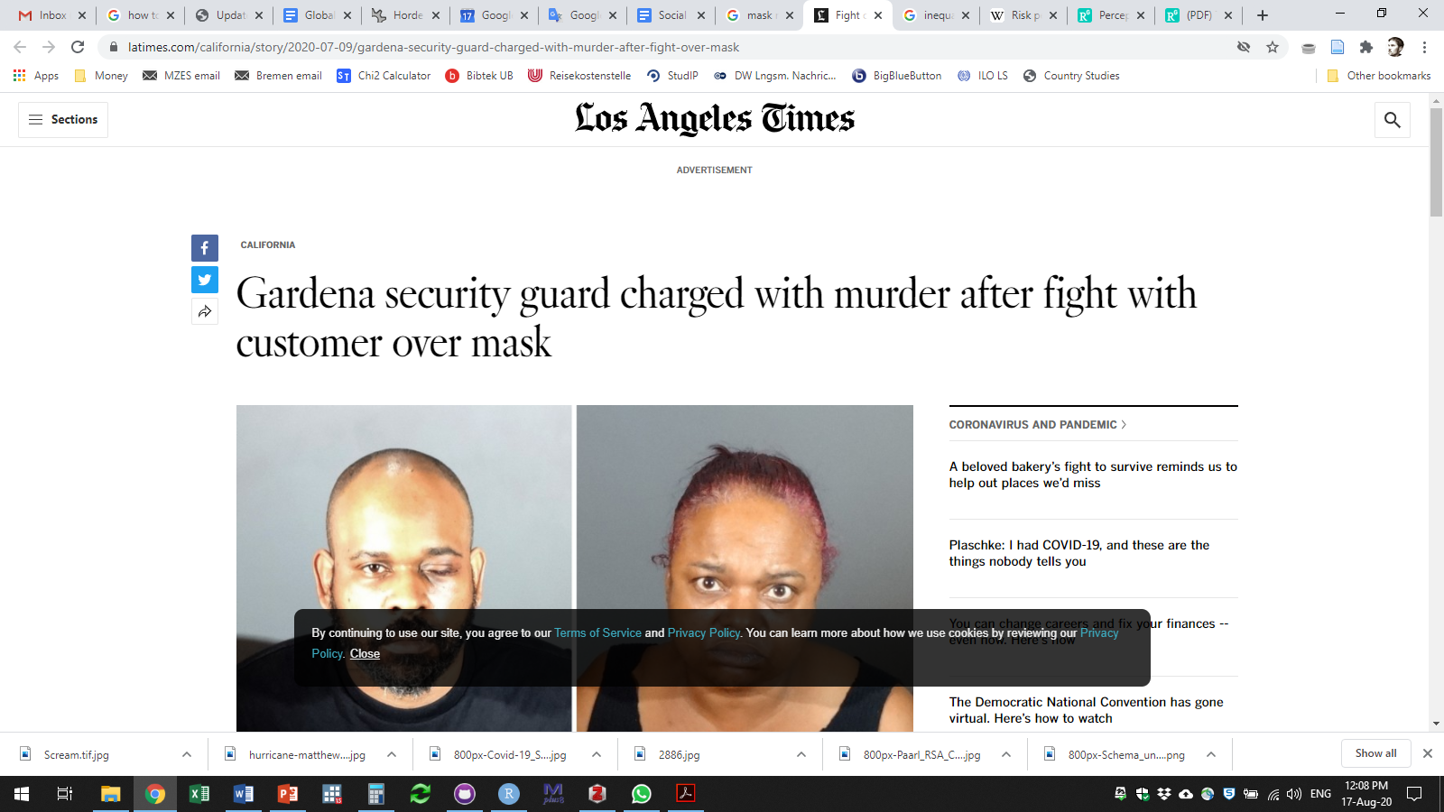
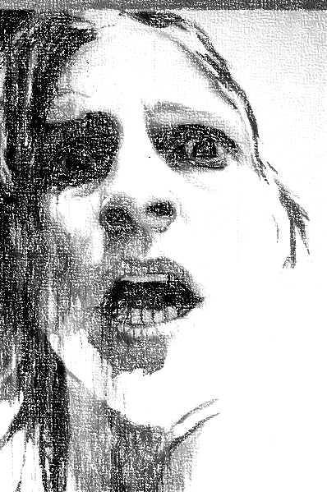
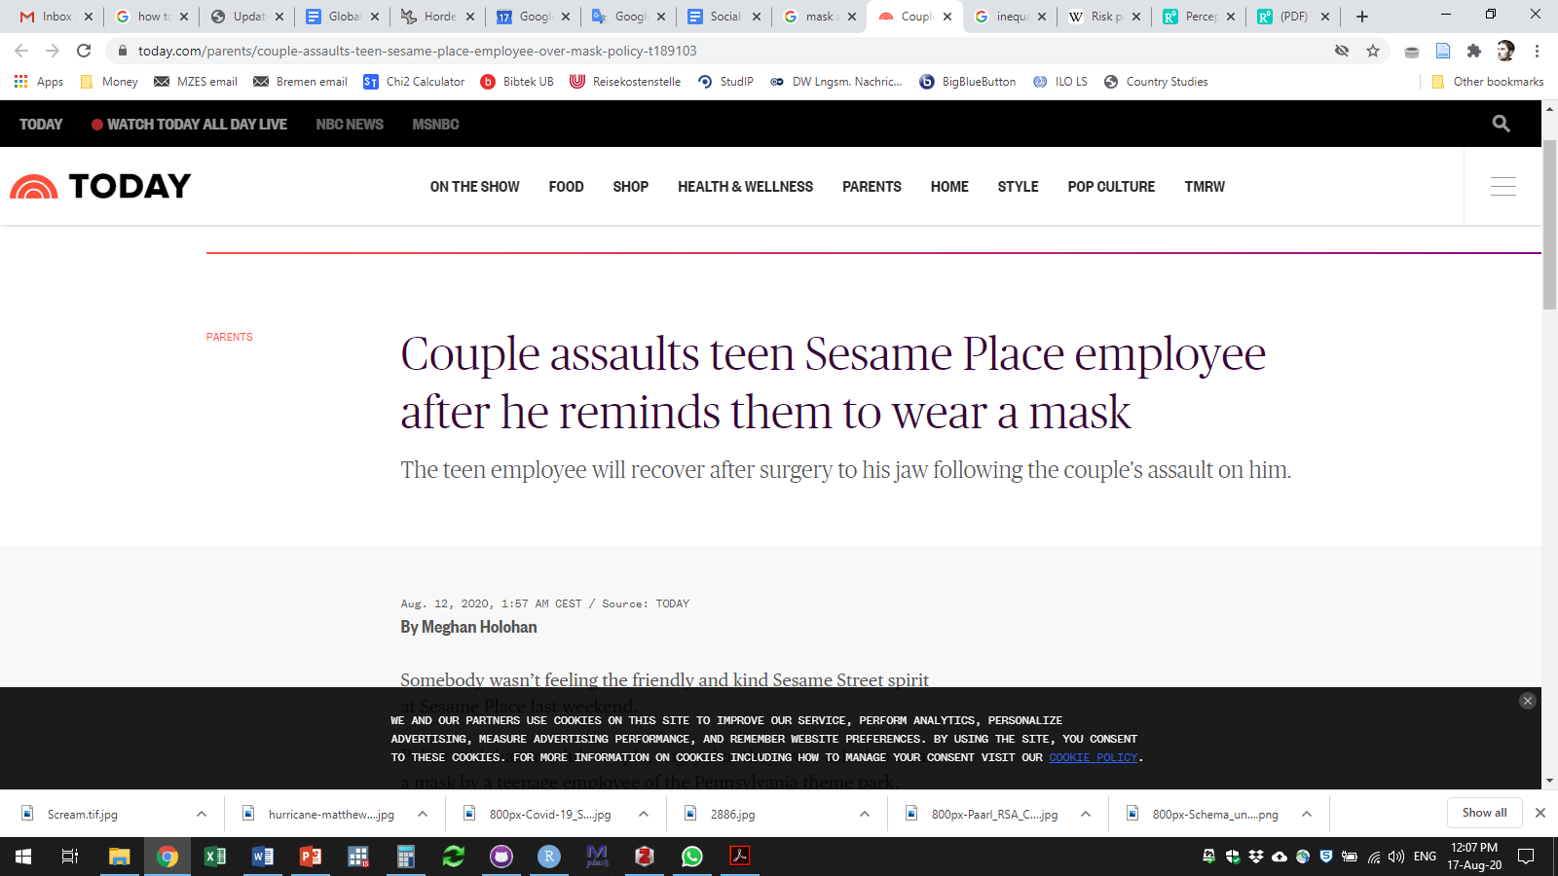
Risk Perceptions and Social Inequality
Risk perceptions
(Taylor‐Gooby and Zinn 2006; Lerner and Keltner 2001)
Basis for decisions
Mental health
Risk society
Avoidance
Unnecessary risk-seeking
https://commons.wikimedia.org/wiki/File:Scream.tif

Slide 9
Risk Perceptions and Social Inequality
?
Does Inequality Increase Risk Perceptions in a Pandemic?

Slide 10
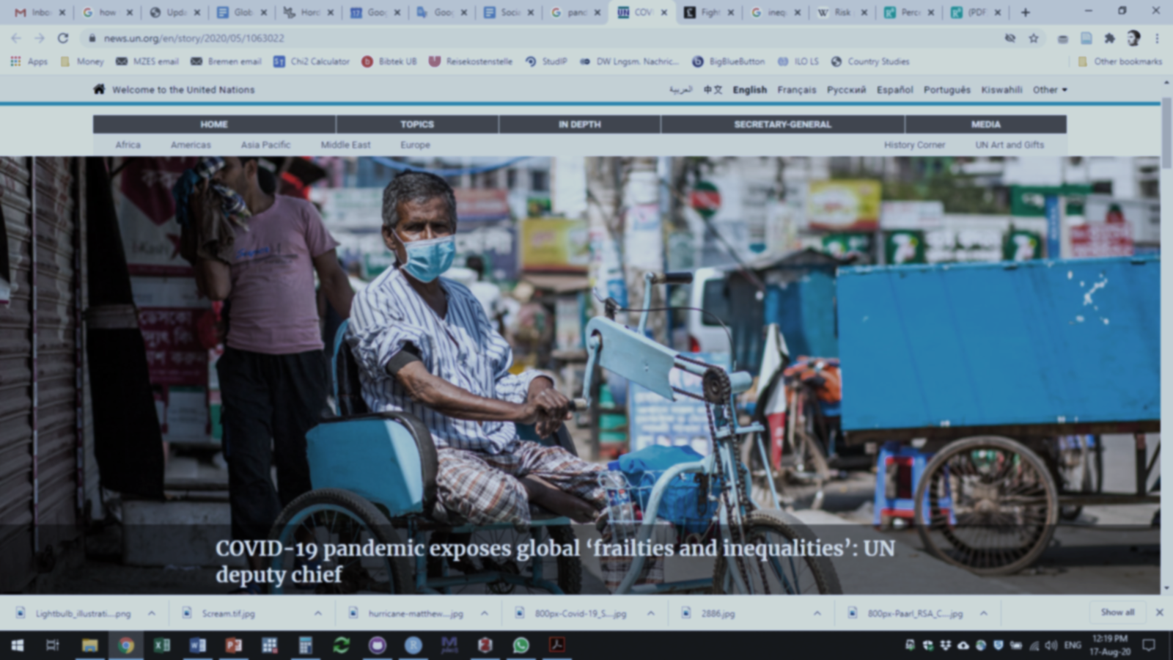
Risk Perceptions and Social Inequality
The Swedish paradox?
Does Inequality Increase Risk Perceptions in a Pandemic?
https://news.un.org/en/story/2020/05/1063022

Slide 11
Research Design
Risk Perceptions = f(Social Inequality)?
Risk Perceptions. Caused by Severity of Outbreak
Risk Perception = Days Since Curve Inflection + New Cases Past Week + Government Intervention
Regress Risk Perceptions on Local Outbreak Severity
Include measures of Social Inequality
Disposable Income Inequality (Gini)
Top 1% Income Concentration
Test Alternatives
Welfare State
Wealth = GDP
Robustness
Regress Risk Perception residuals on Income Inequality
Repeat analysis for plausible range of country-level means

Slide 12
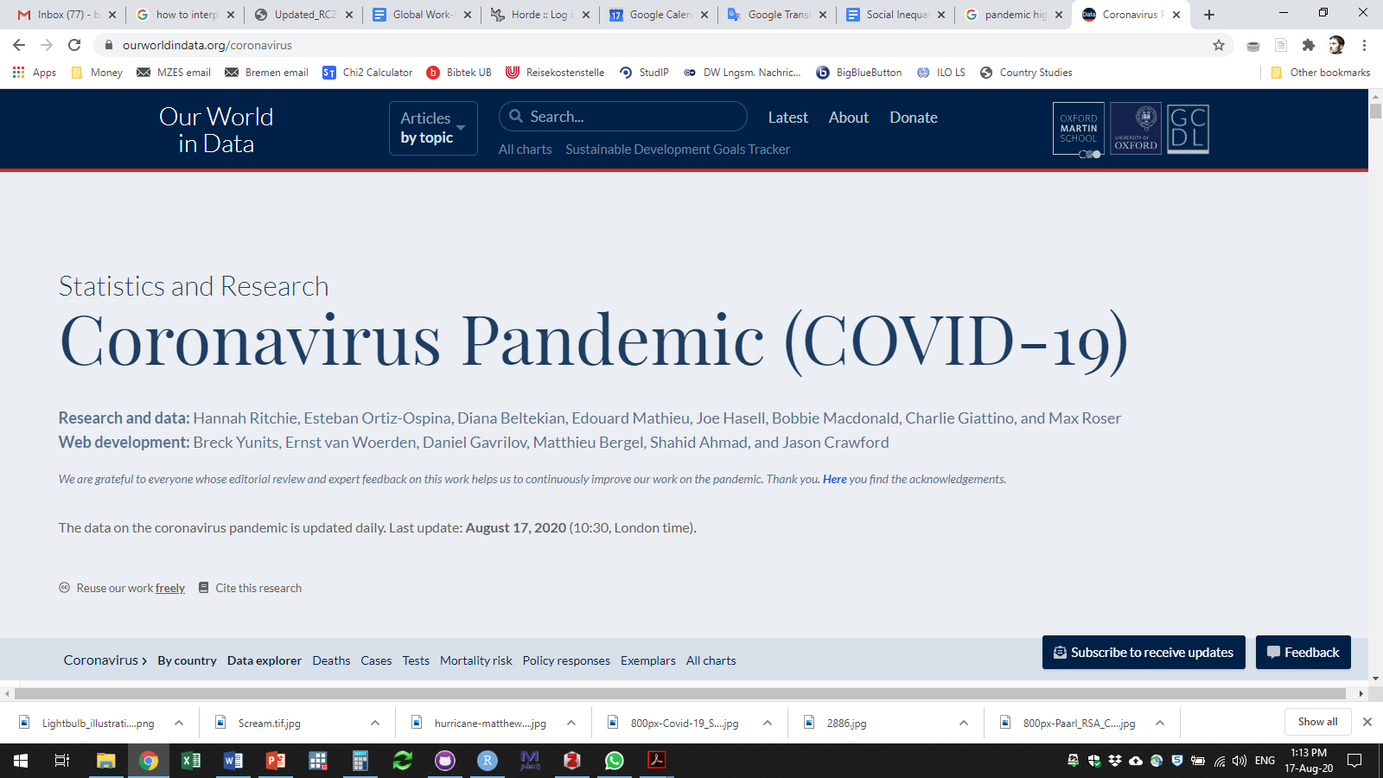
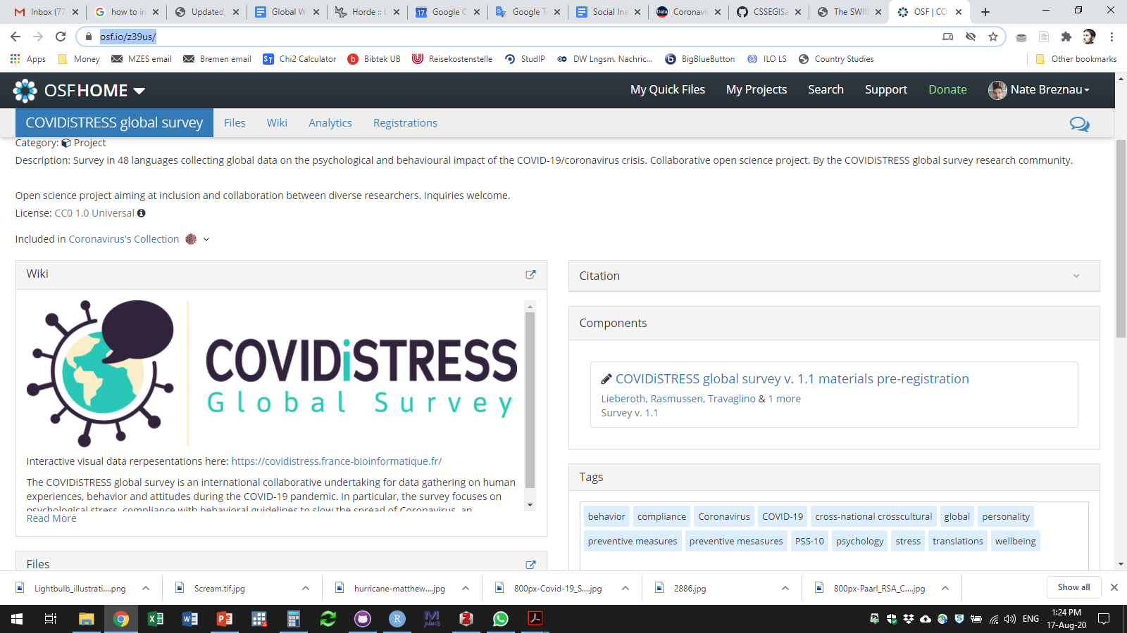
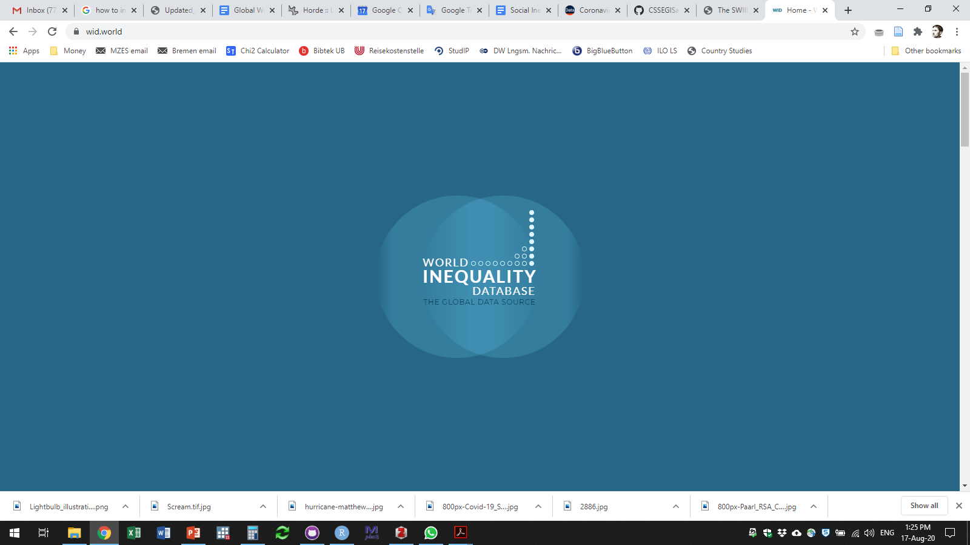
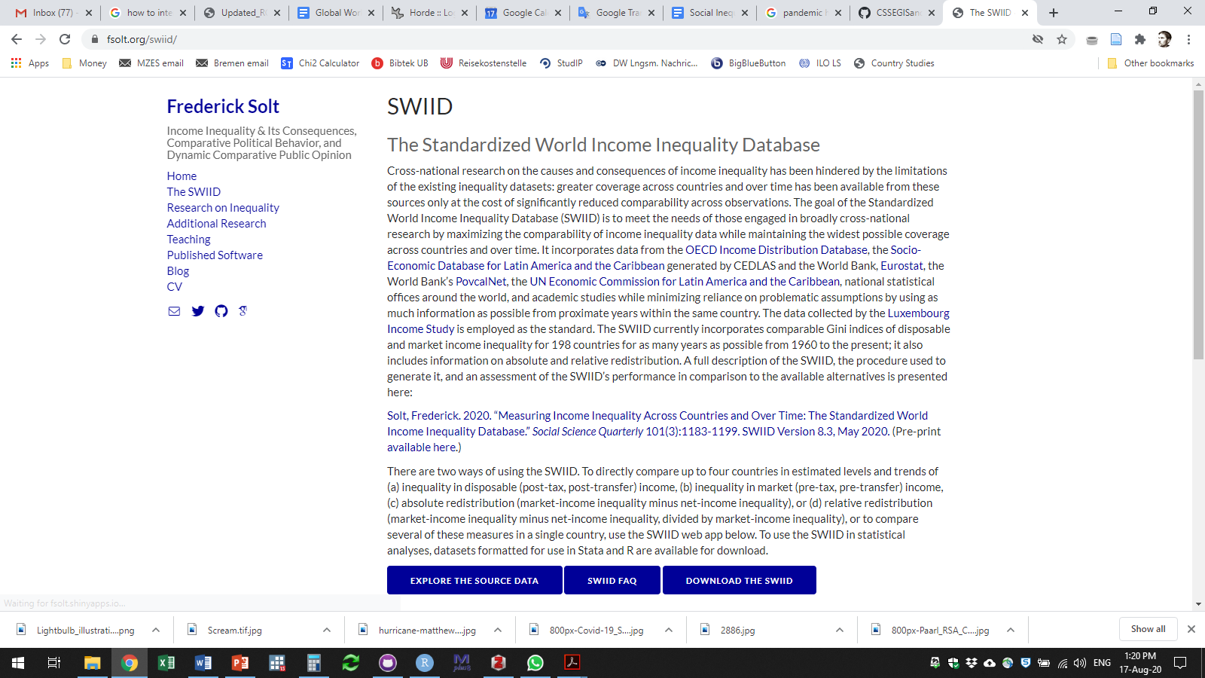
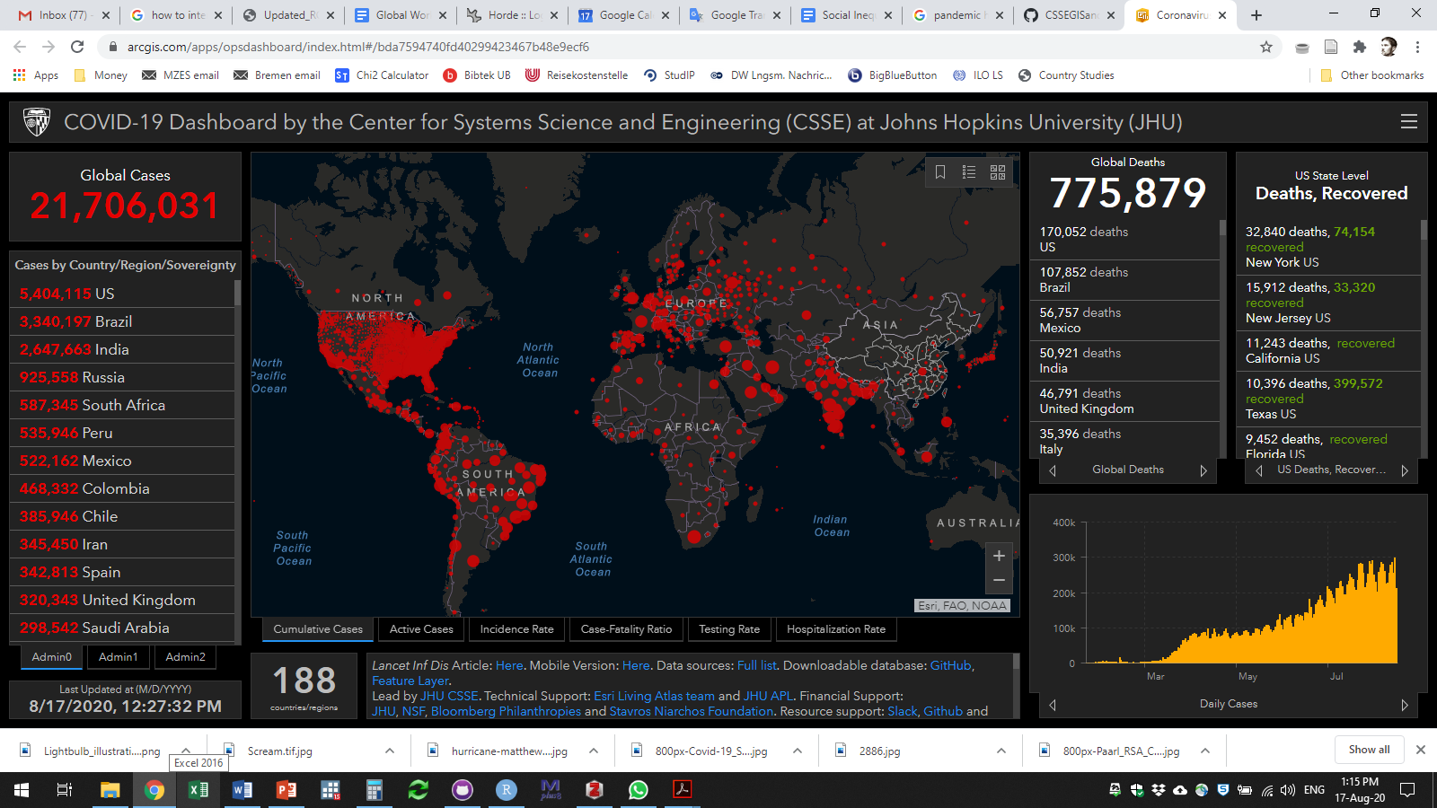
Data Sources

Slide 13
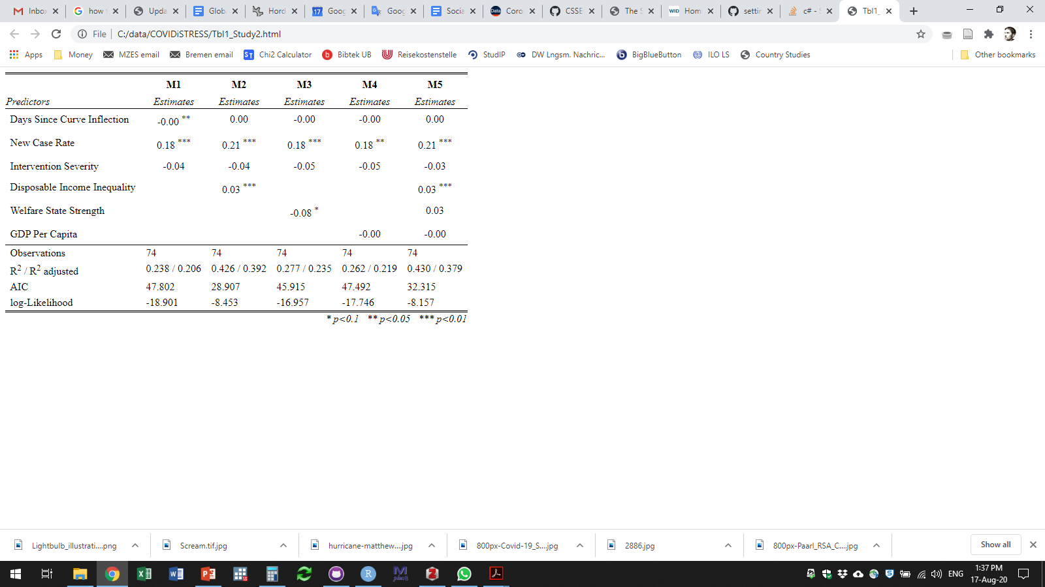
Regression Results – Main Models

Slide 14
Regression Results – Main Models
stdz = 0.50

Slide 15
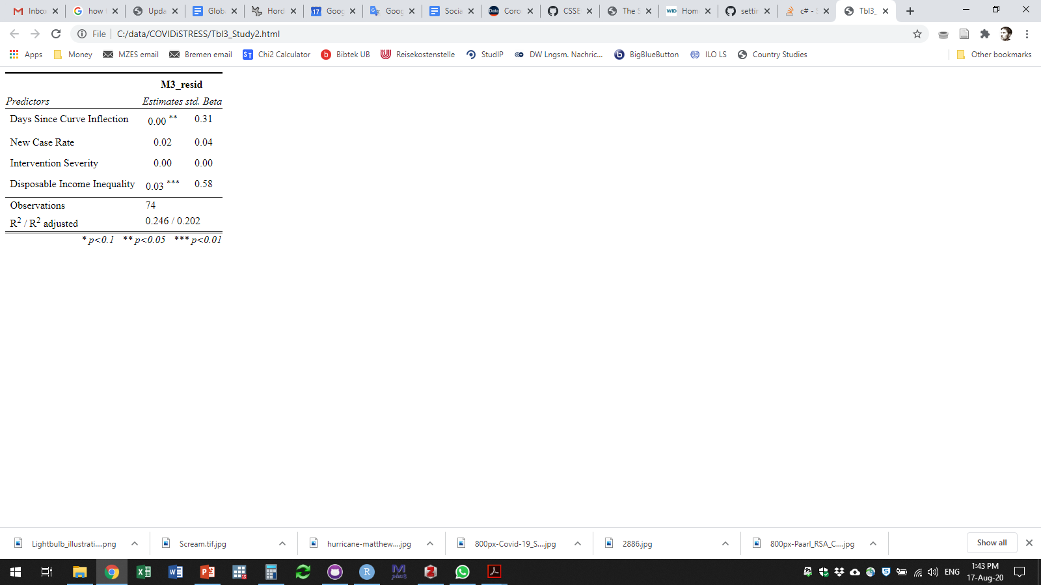
Regression Results – M1 Residuals
M1_resid

Slide 16
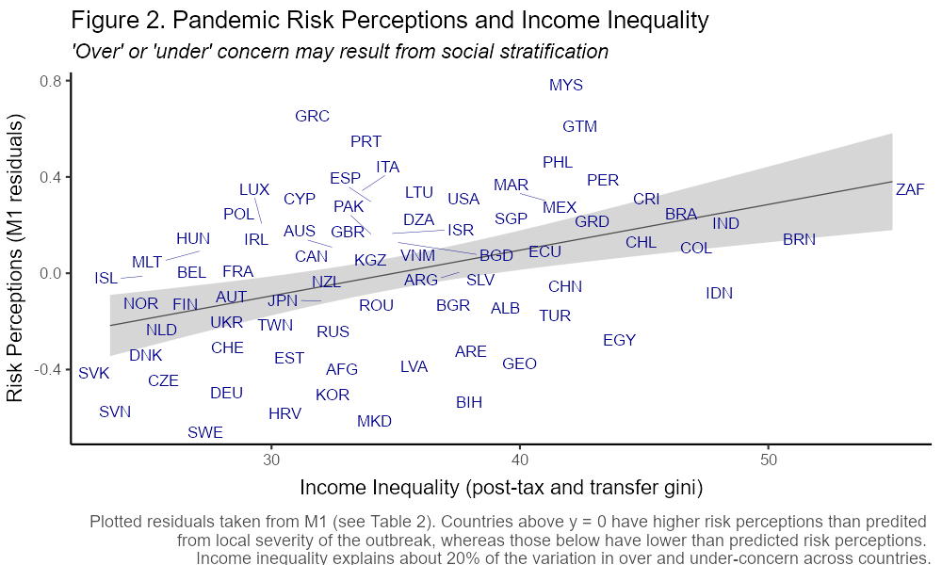
Regression Results – M2 Residuals

Slide 17
Regression Results – M2 Residuals
‘over’-concerned
‘under’-concerned

Slide 18
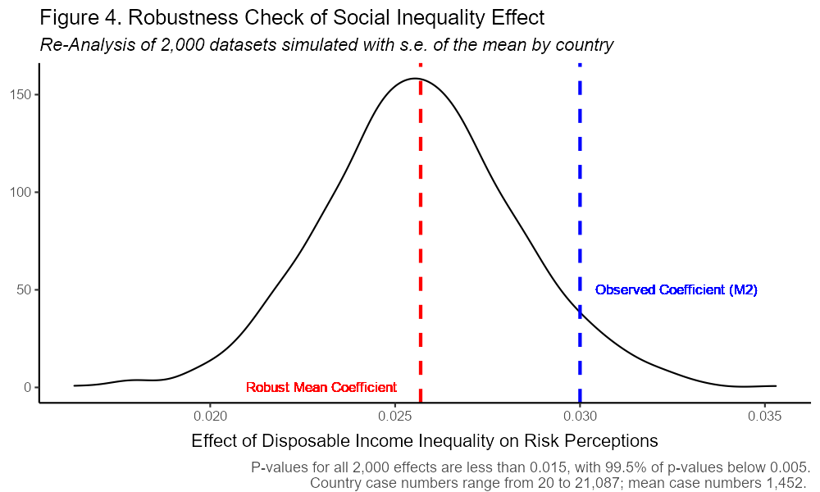
Robustness Check

Slide 19
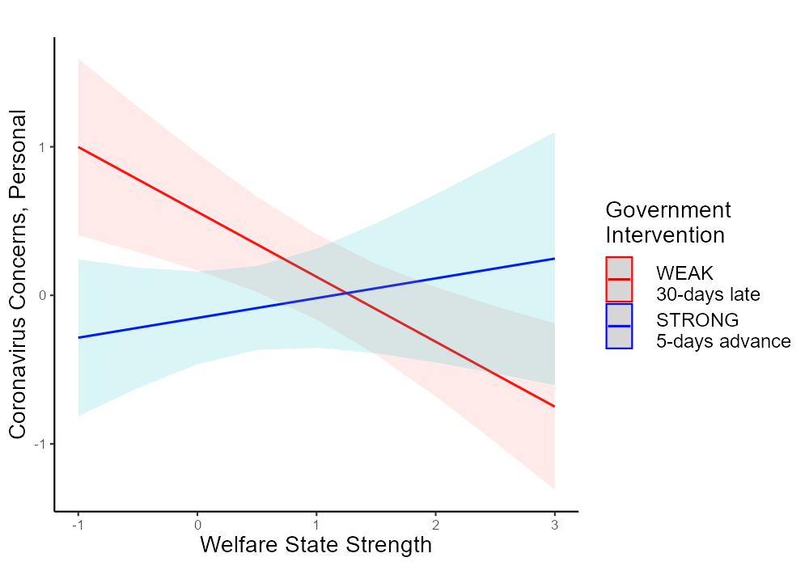
Implications for Previous Finding
(Breznau 2020)

Slide 20
Implications
Social inequality shapes risk perceptions
Social inequality as indicator of causes
Social safety net
Social trust
Class or group conflict
General risk increase
Elite interests / de-democratization
Issues
Online survey sampling
No individual level estimates

Slide 21
Thank You
Replication Materials:
Via OSF https://osf.io/muhdz/ (see “Study Two”)
HTML file with code and results (direct access)
https://osf.io/jysm9/

Slide 22
References
Brady, David, Ryan M. Finnigan, and Sabine Hübgen. 2017. “Rethinking the Risks of Poverty: A Framework for Analyzing Prevalences and Penalties.” American Journal of Sociology 123(3):740–86.
Breznau, Nate. 2020. “The Welfare State and Risk Perceptions: The Novel Coronavirus Pandemic and Public Concern in 70 Countries.” European Societies 0(0):1–14.
Lerner, Jennifer S., and Dacher Keltner. 2001. “Fear, Anger, and Risk.” Journal of Personality and Social Psychology 81(1):146–59.
Lieberoth, Andreas, Dominik-Borna Ćepulić, Jesper Rasmussen, Giovanni A. Travaglino, Jarno Tuominen, and Thao Tran. 2020. “COVIDiSTRESS Global Survey.” Open Science Framework (Osf.Io/Z39us).
Taylor‐Gooby, Peter, and Jens O. Zinn. 2006. “Current Directions in Risk Research: New Developments in Psychology and Sociology.” Risk Analysis 26(2):397–411.
Van de Werfhorst, Herman G., and Wiemer Salverda. 2012. “Consequences of Economic Inequality: Introduction to a Special Issue.” Research in Social Stratification and Mobility 30(4):377–87.
Data Sources:
Johns Hopkins Data https://github.com/CSSEGISandData/COVID-19
Our World In Data https://ourworldindata.org/coronavirus
Solt Inequality Data https://fsolt.org/swiid/
World Inequality Database https://wid.world/
COVIDiSTRESS Survey https://osf.io/z39us/

Slide 23
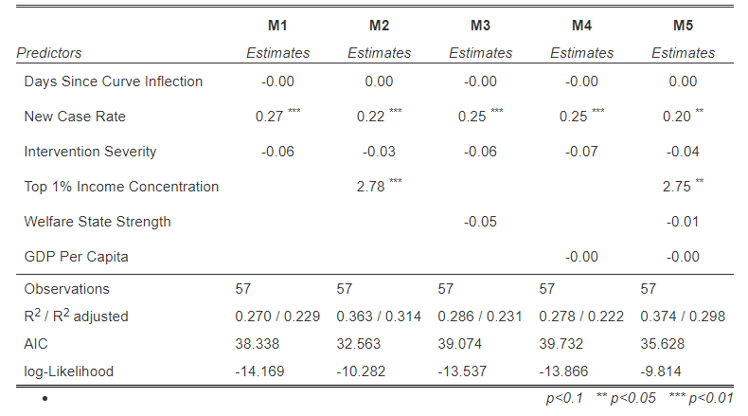
Appendix – Regression Results with Top 1% Income

